Slide 1
Classification
Basic Introduction

Slide 2
Supervised vs. Unsupervised Learning
Supervised learning (classification)
  Supervision: The training data (observations, measurements, etc.) are accompanied by labels indicating the class of the observations
  New data is classified based on the training set
Unsupervised learning (clustering)
  The class labels of training data is unknown
  Given a set of measurements, observations, etc. with the aim of establishing the existence of classes or clusters in the data

Slide 3
Prediction Problems: Classification vs. Numeric Prediction
Classification
  predicts categorical class labels (discrete or nominal)
  classifies data (constructs a model) based on the training set and the values (class labels) in a classifying attribute and uses it in classifying new data
Numeric Prediction
  models continuous-valued functions, i.e., predicts unknown or missing values
Typical applications
  Credit/loan approval:
  Medical diagnosis: if a tumor is cancerous or benign
  Fraud detection: if a transaction is fraudulent
  Web page categorization: which category it is

Slide 4
Classification—A Two-Step Process
Model construction: describing a set of predetermined classes
  Each tuple/sample is assumed to belong to a predefined class, as determined by the class label attribute
  The set of tuples used for model construction is training set
  The model is represented as classification rules, decision trees, or mathematical formulae
Model usage: for classifying future or unknown objects
  Estimate accuracy of the model
    The known label of test sample is compared with the classified result from the model
    Accuracy rate is the percentage of test set samples that are correctly classified by the model
    Test set is independent of training set (otherwise overfitting)
  If the accuracy is acceptable, use the model to classify new data
Note: If the test set is used to select models, it is called validation (test) set

Slide 5
Classification: Definition
Given a collection of records (training set )
  Each record contains a set of attributes, one of the attributes is the class.
Find a model for class attribute as a function of the values of other attributes.
Goal: previously unseen records should be assigned a class as accurately as possible.
  A test set is used to determine the accuracy of the model. Usually, the given data set is divided into training and test sets, with training set used to build the model and test set used to validate it.

Slide 6
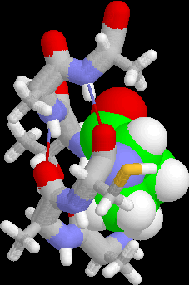
Classification: Examples
Predicting tumor cells as benign or malignant
Classifying credit card transactions
as legitimate or fraudulent
Classifying secondary structures of protein
as alpha-helix, beta-sheet, or random
coil
Categorizing news stories as finance,
weather, entertainment, sports, etc

Slide 7
Classification: Illustration
How to make a model?

Slide 8
Classification Model: Techniques
Rule-based Methods
  1R
Probabilistic methods
  Naïve Bayes
Tree based methods
  Decision Tree
Distance based methods
  K nearest neigbour
Neural Networks
  Perceptrons
  Feed-forward networks
  Convolutional Neural Networks
  Deep Neural Networks
  Recurrent Neural Networks

Slide 9
Classification
1R and Naïve BAYES

Slide 10
Simple Models First
1r, naïve bayes

Slide 11
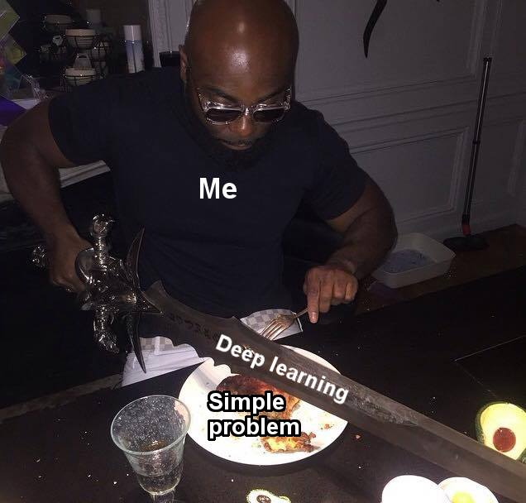
Simplicity First
Simple modeling methods often work very well!
There are many kinds of simple structure, e.g.,
  One attribute does all the work
  All attributes contribute equally and independently
  A weighted linear combination of attributes might do!
  Use simple logic rules!
Success of the method depends on the domain

Slide 12
1R : A rule based approach
Learns a 1-level decision tree
  i.e., rules that test only one particular attribute
Basic version
  One branch for each value
  Each branch assigns most frequent class
  Error rate: proportion of instances that don’t belong to the majority class of their corresponding branch
  Choose attribute with lowest error rate
  Assumes nominal attributes

Slide 13
Pseudo-code for 1R
For each attribute, For each value of the attribute, make a rule as follows: count how often each class appears find the most frequent class make the rule assign that class to this attribute-value Calculate the error rate of the rules Choose the rules with the smallest error rate
Note: “missing” is treated as a separate attribute value

Slide 14
1R: Example
Outlook | Temp | Humidity | Windy | Play
Sunny | Hot | High | False | No
Sunny | Hot | High | True | No
Overcast | Hot | High | False | Yes
Rainy | Mild | High | False | Yes
Rainy | Cool | Normal | False | Yes
Rainy | Cool | Normal | True | No
Overcast | Cool | Normal | True | Yes
Sunny | Mild | High | False | No
Sunny | Cool | Normal | False | Yes
Rainy | Mild | Normal | False | Yes
Sunny | Mild | Normal | True | Yes
Overcast | Mild | High | True | Yes
Overcast | Hot | Normal | False | Yes
Rainy | Mild | High | True | No
Attribute | Rules | Errors | Total errors
Outlook
Temp
Humidity
Windy

Slide 15
1R: Example
Outlook | Temp | Humidity | Windy | Play
Sunny | Hot | High | False | No
Sunny | Hot | High | True | No
Overcast | Hot | High | False | Yes
Rainy | Mild | High | False | Yes
Rainy | Cool | Normal | False | Yes
Rainy | Cool | Normal | True | No
Overcast | Cool | Normal | True | Yes
Sunny | Mild | High | False | No
Sunny | Cool | Normal | False | Yes
Rainy | Mild | Normal | False | Yes
Sunny | Mild | Normal | True | Yes
Overcast | Mild | High | True | Yes
Overcast | Hot | Normal | False | Yes
Rainy | Mild | High | True | No
Attribute | Rules | Errors | Total errors
Outlook | Sunny
 | Overcast
 | Rainy
Temp
Humidity
Windy

Slide 16
1R: Example
Outlook | Temp | Humidity | Windy | Play
Sunny | Hot | High | False | No
Sunny | Hot | High | True | No
Overcast | Hot | High | False | Yes
Rainy | Mild | High | False | Yes
Rainy | Cool | Normal | False | Yes
Rainy | Cool | Normal | True | No
Overcast | Cool | Normal | True | Yes
Sunny | Mild | High | False | No
Sunny | Cool | Normal | False | Yes
Rainy | Mild | Normal | False | Yes
Sunny | Mild | Normal | True | Yes
Overcast | Mild | High | True | Yes
Overcast | Hot | Normal | False | Yes
Rainy | Mild | High | True | No
Attribute | Rules | Errors | Total errors
Outlook | Sunny → No
 | Overcast → Yes
 | Rainy → Yes
Temp
Humidity
Windy

Slide 17
1R: Example
Outlook | Temp | Humidity | Windy | Play
Sunny | Hot | High | False | No
Sunny | Hot | High | True | No
Overcast | Hot | High | False | Yes
Rainy | Mild | High | False | Yes
Rainy | Cool | Normal | False | Yes
Rainy | Cool | Normal | True | No
Overcast | Cool | Normal | True | Yes
Sunny | Mild | High | False | No
Sunny | Cool | Normal | False | Yes
Rainy | Mild | Normal | False | Yes
Sunny | Mild | Normal | True | Yes
Overcast | Mild | High | True | Yes
Overcast | Hot | Normal | False | Yes
Rainy | Mild | High | True | No
Attribute | Rules | Errors | Total errors
Outlook | Sunny → No | 2/5
 | Overcast → Yes | 0/4
 | Rainy → Yes | 2/5
Temp
Humidity
Windy

Slide 18
1R: Example
Outlook | Temp | Humidity | Windy | Play
Sunny | Hot | High | False | No
Sunny | Hot | High | True | No
Overcast | Hot | High | False | Yes
Rainy | Mild | High | False | Yes
Rainy | Cool | Normal | False | Yes
Rainy | Cool | Normal | True | No
Overcast | Cool | Normal | True | Yes
Sunny | Mild | High | False | No
Sunny | Cool | Normal | False | Yes
Rainy | Mild | Normal | False | Yes
Sunny | Mild | Normal | True | Yes
Overcast | Mild | High | True | Yes
Overcast | Hot | Normal | False | Yes
Rainy | Mild | High | True | No
Attribute | Rules | Errors | Total errors
Outlook | Sunny → No | 2/5 | 4/14
 | Overcast → Yes | 0/4
 | Rainy → Yes | 2/5
Temp
Humidity
Windy

Slide 19
1R: Example
Outlook | Temp | Humidity | Windy | Play
Sunny | Hot | High | False | No
Sunny | Hot | High | True | No
Overcast | Hot | High | False | Yes
Rainy | Mild | High | False | Yes
Rainy | Cool | Normal | False | Yes
Rainy | Cool | Normal | True | No
Overcast | Cool | Normal | True | Yes
Sunny | Mild | High | False | No
Sunny | Cool | Normal | False | Yes
Rainy | Mild | Normal | False | Yes
Sunny | Mild | Normal | True | Yes
Overcast | Mild | High | True | Yes
Overcast | Hot | Normal | False | Yes
Rainy | Mild | High | True | No
Attribute | Rules | Errors | Total errors
Outlook | Sunny → No | 2/5 | 4/14
 | Overcast → Yes | 0/4
 | Rainy → Yes | 2/5
Temp | Hot
 | Mild
 | Cool
Humidity
Windy

Slide 20
1R: Example
Outlook | Temp | Humidity | Windy | Play
Sunny | Hot | High | False | No
Sunny | Hot | High | True | No
Overcast | Hot | High | False | Yes
Rainy | Mild | High | False | Yes
Rainy | Cool | Normal | False | Yes
Rainy | Cool | Normal | True | No
Overcast | Cool | Normal | True | Yes
Sunny | Mild | High | False | No
Sunny | Cool | Normal | False | Yes
Rainy | Mild | Normal | False | Yes
Sunny | Mild | Normal | True | Yes
Overcast | Mild | High | True | Yes
Overcast | Hot | Normal | False | Yes
Rainy | Mild | High | True | No
Attribute | Rules | Errors | Total errors
Outlook | Sunny → No | 2/5 | 4/14
 | Overcast → Yes | 0/4
 | Rainy → Yes | 2/5
Temp | Hot → No*
 | Mild → Yes
 | Cool → Yes
Humidity
Windy
* indicates a tie

Slide 21
1R: Example
Outlook | Temp | Humidity | Windy | Play
Sunny | Hot | High | False | No
Sunny | Hot | High | True | No
Overcast | Hot | High | False | Yes
Rainy | Mild | High | False | Yes
Rainy | Cool | Normal | False | Yes
Rainy | Cool | Normal | True | No
Overcast | Cool | Normal | True | Yes
Sunny | Mild | High | False | No
Sunny | Cool | Normal | False | Yes
Rainy | Mild | Normal | False | Yes
Sunny | Mild | Normal | True | Yes
Overcast | Mild | High | True | Yes
Overcast | Hot | Normal | False | Yes
Rainy | Mild | High | True | No
Attribute | Rules | Errors | Total errors
Outlook | Sunny → No | 2/5 | 4/14
 | Overcast → Yes | 0/4
 | Rainy → Yes | 2/5
Temp | Hot → No* | 2/4
 | Mild → Yes | 2/6
 | Cool → Yes | 1/4
Humidity
Windy
* indicates a tie

Slide 22
1R: Example
Outlook | Temp | Humidity | Windy | Play
Sunny | Hot | High | False | No
Sunny | Hot | High | True | No
Overcast | Hot | High | False | Yes
Rainy | Mild | High | False | Yes
Rainy | Cool | Normal | False | Yes
Rainy | Cool | Normal | True | No
Overcast | Cool | Normal | True | Yes
Sunny | Mild | High | False | No
Sunny | Cool | Normal | False | Yes
Rainy | Mild | Normal | False | Yes
Sunny | Mild | Normal | True | Yes
Overcast | Mild | High | True | Yes
Overcast | Hot | Normal | False | Yes
Rainy | Mild | High | True | No
Attribute | Rules | Errors | Total errors
Outlook | Sunny → No | 2/5 | 4/14
 | Overcast → Yes | 0/4
 | Rainy → Yes | 2/5
Temp | Hot → No* | 2/4 | 5/14
 | Mild → Yes | 2/6
 | Cool → Yes | 1/4
Humidity
Windy
* indicates a tie

Slide 23
1R: Example
Outlook | Temp | Humidity | Windy | Play
Sunny | Hot | High | False | No
Sunny | Hot | High | True | No
Overcast | Hot | High | False | Yes
Rainy | Mild | High | False | Yes
Rainy | Cool | Normal | False | Yes
Rainy | Cool | Normal | True | No
Overcast | Cool | Normal | True | Yes
Sunny | Mild | High | False | No
Sunny | Cool | Normal | False | Yes
Rainy | Mild | Normal | False | Yes
Sunny | Mild | Normal | True | Yes
Overcast | Mild | High | True | Yes
Overcast | Hot | Normal | False | Yes
Rainy | Mild | High | True | No
Attribute | Rules | Errors | Total errors
Outlook | Sunny → No | 2/5 | 4/14
 | Overcast → Yes | 0/4
 | Rainy → Yes | 2/5
Temp | Hot → No* | 2/4 | 5/14
 | Mild → Yes | 2/6
 | Cool → Yes | 1/4
Humidity | High
 | Normal
Windy
* indicates a tie

Slide 24
1R: Example
Outlook | Temp | Humidity | Windy | Play
Sunny | Hot | High | False | No
Sunny | Hot | High | True | No
Overcast | Hot | High | False | Yes
Rainy | Mild | High | False | Yes
Rainy | Cool | Normal | False | Yes
Rainy | Cool | Normal | True | No
Overcast | Cool | Normal | True | Yes
Sunny | Mild | High | False | No
Sunny | Cool | Normal | False | Yes
Rainy | Mild | Normal | False | Yes
Sunny | Mild | Normal | True | Yes
Overcast | Mild | High | True | Yes
Overcast | Hot | Normal | False | Yes
Rainy | Mild | High | True | No
Attribute | Rules | Errors | Total errors
Outlook | Sunny → No | 2/5 | 4/14
 | Overcast → Yes | 0/4
 | Rainy → Yes | 2/5
Temp | Hot → No* | 2/4 | 5/14
 | Mild → Yes | 2/6
 | Cool → Yes | 1/4
Humidity | High → No
 | Normal → Yes
Windy
* indicates a tie

Slide 25
1R: Example
Outlook | Temp | Humidity | Windy | Play
Sunny | Hot | High | False | No
Sunny | Hot | High | True | No
Overcast | Hot | High | False | Yes
Rainy | Mild | High | False | Yes
Rainy | Cool | Normal | False | Yes
Rainy | Cool | Normal | True | No
Overcast | Cool | Normal | True | Yes
Sunny | Mild | High | False | No
Sunny | Cool | Normal | False | Yes
Rainy | Mild | Normal | False | Yes
Sunny | Mild | Normal | True | Yes
Overcast | Mild | High | True | Yes
Overcast | Hot | Normal | False | Yes
Rainy | Mild | High | True | No
Attribute | Rules | Errors | Total errors
Outlook | Sunny → No | 2/5 | 4/14
 | Overcast → Yes | 0/4
 | Rainy → Yes | 2/5
Temp | Hot → No* | 2/4 | 5/14
 | Mild → Yes | 2/6
 | Cool → Yes | 1/4
Humidity | High → No | 3/7
 | Normal → Yes | 1/7
Windy
* indicates a tie

Slide 26
1R: Example
Outlook | Temp | Humidity | Windy | Play
Sunny | Hot | High | False | No
Sunny | Hot | High | True | No
Overcast | Hot | High | False | Yes
Rainy | Mild | High | False | Yes
Rainy | Cool | Normal | False | Yes
Rainy | Cool | Normal | True | No
Overcast | Cool | Normal | True | Yes
Sunny | Mild | High | False | No
Sunny | Cool | Normal | False | Yes
Rainy | Mild | Normal | False | Yes
Sunny | Mild | Normal | True | Yes
Overcast | Mild | High | True | Yes
Overcast | Hot | Normal | False | Yes
Rainy | Mild | High | True | No
Attribute | Rules | Errors | Total errors
Outlook | Sunny → No | 2/5 | 4/14
 | Overcast → Yes | 0/4
 | Rainy → Yes | 2/5
Temp | Hot → No* | 2/4 | 5/14
 | Mild → Yes | 2/6
 | Cool → Yes | 1/4
Humidity | High → No | 3/7 | 4/14
 | Normal → Yes | 1/7
Windy
* indicates a tie

Slide 27
1R: Example
Outlook | Temp | Humidity | Windy | Play
Sunny | Hot | High | False | No
Sunny | Hot | High | True | No
Overcast | Hot | High | False | Yes
Rainy | Mild | High | False | Yes
Rainy | Cool | Normal | False | Yes
Rainy | Cool | Normal | True | No
Overcast | Cool | Normal | True | Yes
Sunny | Mild | High | False | No
Sunny | Cool | Normal | False | Yes
Rainy | Mild | Normal | False | Yes
Sunny | Mild | Normal | True | Yes
Overcast | Mild | High | True | Yes
Overcast | Hot | Normal | False | Yes
Rainy | Mild | High | True | No
Attribute | Rules | Errors | Total errors
Outlook | Sunny → No | 2/5 | 4/14
 | Overcast → Yes | 0/4
 | Rainy → Yes | 2/5
Temp | Hot → No* | 2/4 | 5/14
 | Mild → Yes | 2/6
 | Cool → Yes | 1/4
Humidity | High → No | 3/7 | 4/14
 | Normal → Yes | 1/7
Windy | False
 | True
* indicates a tie

Slide 28
1R: Example
Outlook | Temp | Humidity | Windy | Play
Sunny | Hot | High | False | No
Sunny | Hot | High | True | No
Overcast | Hot | High | False | Yes
Rainy | Mild | High | False | Yes
Rainy | Cool | Normal | False | Yes
Rainy | Cool | Normal | True | No
Overcast | Cool | Normal | True | Yes
Sunny | Mild | High | False | No
Sunny | Cool | Normal | False | Yes
Rainy | Mild | Normal | False | Yes
Sunny | Mild | Normal | True | Yes
Overcast | Mild | High | True | Yes
Overcast | Hot | Normal | False | Yes
Rainy | Mild | High | True | No
Attribute | Rules | Errors | Total errors
Outlook | Sunny → No | 2/5 | 4/14
 | Overcast → Yes | 0/4
 | Rainy → Yes | 2/5
Temp | Hot → No* | 2/4 | 5/14
 | Mild → Yes | 2/6
 | Cool → Yes | 1/4
Humidity | High → No | 3/7 | 4/14
 | Normal → Yes | 1/7
Windy | False → Yes
 | True → No*
* indicates a tie

Slide 29
1R: Example
Outlook | Temp | Humidity | Windy | Play
Sunny | Hot | High | False | No
Sunny | Hot | High | True | No
Overcast | Hot | High | False | Yes
Rainy | Mild | High | False | Yes
Rainy | Cool | Normal | False | Yes
Rainy | Cool | Normal | True | No
Overcast | Cool | Normal | True | Yes
Sunny | Mild | High | False | No
Sunny | Cool | Normal | False | Yes
Rainy | Mild | Normal | False | Yes
Sunny | Mild | Normal | True | Yes
Overcast | Mild | High | True | Yes
Overcast | Hot | Normal | False | Yes
Rainy | Mild | High | True | No
Attribute | Rules | Errors | Total errors
Outlook | Sunny → No | 2/5 | 4/14
 | Overcast → Yes | 0/4
 | Rainy → Yes | 2/5
Temp | Hot → No* | 2/4 | 5/14
 | Mild → Yes | 2/6
 | Cool → Yes | 1/4
Humidity | High → No | 3/7 | 4/14
 | Normal → Yes | 1/7
Windy | False → Yes | 2/8
 | True → No* | 3/6
* indicates a tie

Slide 30
1R: Example
Outlook | Temp | Humidity | Windy | Play
Sunny | Hot | High | False | No
Sunny | Hot | High | True | No
Overcast | Hot | High | False | Yes
Rainy | Mild | High | False | Yes
Rainy | Cool | Normal | False | Yes
Rainy | Cool | Normal | True | No
Overcast | Cool | Normal | True | Yes
Sunny | Mild | High | False | No
Sunny | Cool | Normal | False | Yes
Rainy | Mild | Normal | False | Yes
Sunny | Mild | Normal | True | Yes
Overcast | Mild | High | True | Yes
Overcast | Hot | Normal | False | Yes
Rainy | Mild | High | True | No
Attribute | Rules | Errors | Total errors
Outlook | Sunny → No | 2/5 | 4/14
 | Overcast → Yes | 0/4
 | Rainy → Yes | 2/5
Temp | Hot → No* | 2/4 | 5/14
 | Mild → Yes | 2/6
 | Cool → Yes | 1/4
Humidity | High → No | 3/7 | 4/14
 | Normal → Yes | 1/7
Windy | False → Yes | 2/8 | 5/14
 | True → No* | 3/6
* indicates a tie

Slide 31
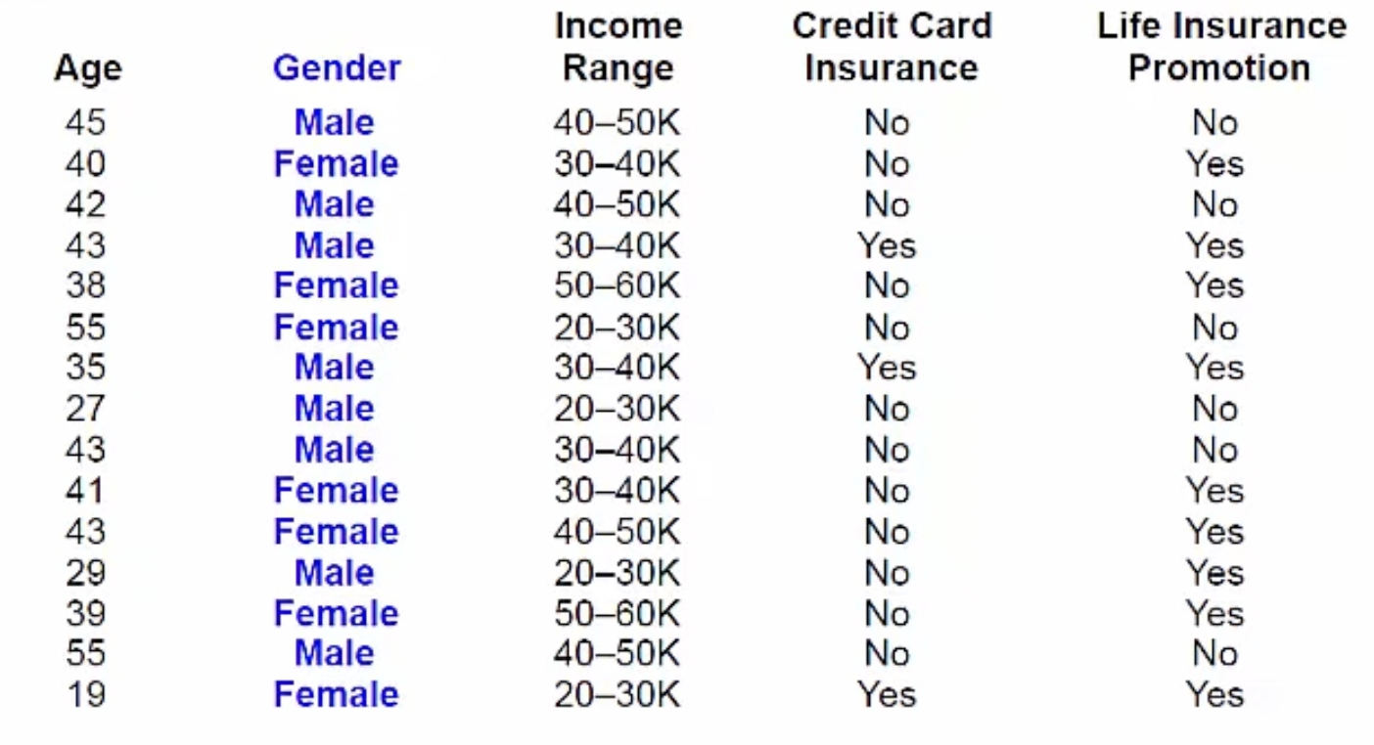
Activity

Slide 32
What if Attributes are Numeric?
Discretize numeric attributes
Divide each attribute’s range into intervals
  Sort instances according to attribute’s values
  Place breakpoints where the class changes
  (the majority class)
  This minimizes the total error
Example: temperature from weather data
Outlook | Temperature | Humidity | Windy | Play
Sunny | 85 | 85 | False | No
Sunny | 80 | 90 | True | No
Overcast | 83 | 86 | False | Yes
Rainy | 75 | 80 | False | Yes
… | … | … | … | …
64 65 68 69 70 71 72 72 75 75 80 81 83 85 Yes | No | Yes Yes Yes | No No Yes | Yes Yes | No | Yes Yes | No

Slide 33
The problem of overfitting
This procedure is very sensitive to noise
  One instance with an incorrect class label will probably produce a separate interval
Simple solution:
enforce minimum number of instances in majority class per interval
Overfitting is an undesirable machine learning behaviour that occurs when the machine learning model gives accurate predictions for training data but not for new data.

Slide 34
Discretization: Example
Example (with min majority class = 3):
Final result for temperature attribute
64 65 68 69 70 71 72 72 75 75 80 81 83 85 Yes | No | Yes Yes Yes | No No Yes | Yes Yes | No | Yes Yes | No
64 65 68 69 70 71 72 72 75 75 80 81 83 85 Yes No Yes Yes Yes | No No Yes Yes Yes | No Yes Yes No

Slide 35
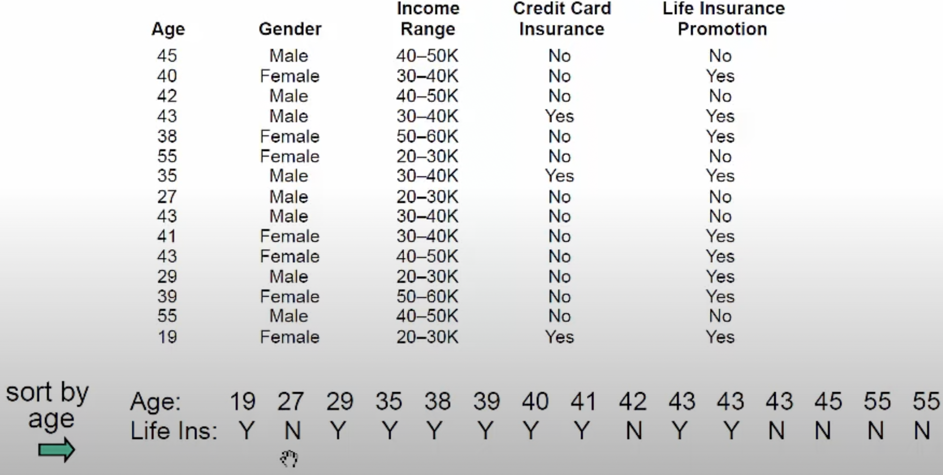
Numeric Attribute “Age”

Slide 36
1R: With Overfitting Avoidance
64 65 68 69 70 71 72 72 75 75 80 81 83 85 Yes No Yes Yes Yes No No Yes Yes Yes | No Yes Yes No
Attribute | Rules | Errors | Total errors
Outlook | Sunny → No | 2/5 | 4/14
 | Overcast → Yes | 0/4
 | Rainy → Yes | 2/5
Temperature | ≤ 77.5 → Yes | 3/10 | 5/14
 | > 77.5 → No* | 2/4
Humidity | ≤ 82.5 → Yes | 1/7 | 3/14
 | > 82.5 and ≤ 95.5 → No | 2/6
 | > 95.5 → Yes | 0/1
Windy | False → Yes | 2/8 | 5/14
 | True → No* | 3/6
Resulting Rule Set:
* indicates a tie

Slide 37

Discussion of 1R
1R was described in a paper by Holte (1993)
  Contains an experimental evaluation on 16 datasets (using cross-validation so that results were representative of performance on future data)
  Minimum number of instances was set to 6 after some experimentation
  1R’s simple rules performed not much worse than much more complex decision trees
Simplicity first pays off!
Very Simple Classification Rules Perform Well on Most Commonly Used Datasets
Robert C. Holte, Computer Science Department, University of Ottawa

Slide 38
Naïve Bayes

Slide 39
Bayesian (Statistical) Modeling
“Opposite” of 1R: use all the attributes
Two assumptions: Attributes are
  equally important
  statistically independent (given the class value)
    i.e., knowing the value of one attribute says nothing about the value of another
    (if the class is known)
Independence assumption is almost never correct!
But … this scheme works well in practice

Slide 40
Naïve Bayes: Probabilities
Outlook | Temp | Humidity | Windy | Play
Sunny | Hot | High | False | No
Sunny | Hot | High | True | No
Overcast | Hot | High | False | Yes
Rainy | Mild | High | False | Yes
Rainy | Cool | Normal | False | Yes
Rainy | Cool | Normal | True | No
Overcast | Cool | Normal | True | Yes
Sunny | Mild | High | False | No
Sunny | Cool | Normal | False | Yes
Rainy | Mild | Normal | False | Yes
Sunny | Mild | Normal | True | Yes
Overcast | Mild | High | True | Yes
Overcast | Hot | Normal | False | Yes
Rainy | Mild | High | True | No
Outlook |  |  | Temperature |  |  | Humidity |  |  | Windy |  |  | Play
Step 1: Compute all the counts for all values of all attributes in each class!!

Slide 41
Naïve Bayes: Probabilities
Outlook | Temp | Humidity | Windy | Play
Sunny | Hot | High | False | No
Sunny | Hot | High | True | No
Overcast | Hot | High | False | Yes
Rainy | Mild | High | False | Yes
Rainy | Cool | Normal | False | Yes
Rainy | Cool | Normal | True | No
Overcast | Cool | Normal | True | Yes
Sunny | Mild | High | False | No
Sunny | Cool | Normal | False | Yes
Rainy | Mild | Normal | False | Yes
Sunny | Mild | Normal | True | Yes
Overcast | Mild | High | True | Yes
Overcast | Hot | Normal | False | Yes
Rainy | Mild | High | True | No
Outlook |  |  | Temperature |  |  | Humidity |  |  | Windy |  |  | Play
 | Yes | No |  | Yes | No |  | Yes | No |  | Yes | No | Yes | No
Sunny |  |  | Hot |  |  | High |  |  | False
Overcast |  |  | Mild |  |  | Normal |  |  | True
Rainy |  |  | Cool
Step 1: Compute all the counts for all values of all attributes in each class!!

Slide 42
Naïve Bayes: Probabilities
Outlook | Temp | Humidity | Windy | Play
Sunny | Hot | High | False | No
Sunny | Hot | High | True | No
Overcast | Hot | High | False | Yes
Rainy | Mild | High | False | Yes
Rainy | Cool | Normal | False | Yes
Rainy | Cool | Normal | True | No
Overcast | Cool | Normal | True | Yes
Sunny | Mild | High | False | No
Sunny | Cool | Normal | False | Yes
Rainy | Mild | Normal | False | Yes
Sunny | Mild | Normal | True | Yes
Overcast | Mild | High | True | Yes
Overcast | Hot | Normal | False | Yes
Rainy | Mild | High | True | No
Outlook |  |  | Temperature |  |  | Humidity |  |  | Windy |  |  | Play
 | Yes | No |  | Yes | No |  | Yes | No |  | Yes | No | Yes | No
Sunny | 2 | 3 | Hot | 2 | 2 | High | 3 | 4 | False | 6 | 2 | 9 | 5
Overcast | 4 | 0 | Mild | 4 | 2 | Normal | 6 | 1 | True | 3 | 3
Rainy | 3 | 2 | Cool | 3 | 1
Step 2: Compute Prior probabilities for each class

Slide 43
Naïve Bayes: Probabilities
Outlook | Temp | Humidity | Windy | Play
Sunny | Hot | High | False | No
Sunny | Hot | High | True | No
Overcast | Hot | High | False | Yes
Rainy | Mild | High | False | Yes
Rainy | Cool | Normal | False | Yes
Rainy | Cool | Normal | True | No
Overcast | Cool | Normal | True | Yes
Sunny | Mild | High | False | No
Sunny | Cool | Normal | False | Yes
Rainy | Mild | Normal | False | Yes
Sunny | Mild | Normal | True | Yes
Overcast | Mild | High | True | Yes
Overcast | Hot | Normal | False | Yes
Rainy | Mild | High | True | No
Outlook |  |  | Temperature |  |  | Humidity |  |  | Windy |  |  | Play
 | Yes | No |  | Yes | No |  | Yes | No |  | Yes | No | Yes | No
Sunny | 2 | 3 | Hot | 2 | 2 | High | 3 | 4 | False | 6 | 2 | 9 | 5
Overcast | 4 | 0 | Mild | 4 | 2 | Normal | 6 | 1 | True | 3 | 3
Rainy | 3 | 2 | Cool | 3 | 1
 |  |  |  |  |  |  |  |  |  |  |  | 9/14 | 5/14
Prior probability means: without looking into attributes, what are the chances that a record belongs to a particular class.
Step 2: Compute Prior probabilities for each class

Slide 44
Naïve Bayes: Probabilities
Outlook | Temp | Humidity | Windy | Play
Sunny | Hot | High | False | No
Sunny | Hot | High | True | No
Overcast | Hot | High | False | Yes
Rainy | Mild | High | False | Yes
Rainy | Cool | Normal | False | Yes
Rainy | Cool | Normal | True | No
Overcast | Cool | Normal | True | Yes
Sunny | Mild | High | False | No
Sunny | Cool | Normal | False | Yes
Rainy | Mild | Normal | False | Yes
Sunny | Mild | Normal | True | Yes
Overcast | Mild | High | True | Yes
Overcast | Hot | Normal | False | Yes
Rainy | Mild | High | True | No
Outlook |  |  | Temperature |  |  | Humidity |  |  | Windy |  |  | Play
 | Yes | No |  | Yes | No |  | Yes | No |  | Yes | No | Yes | No
Sunny | 2 | 3 | Hot | 2 | 2 | High | 3 | 4 | False | 6 | 2 | 9 | 5
Overcast | 4 | 0 | Mild | 4 | 2 | Normal | 6 | 1 | True | 3 | 3
Rainy | 3 | 2 | Cool | 3 | 1
Sunny |  |  | Hot |  |  | High |  |  | False |  |  | 9/14 | 5/14
Overcast |  |  | Mild |  |  | Normal |  |  | True
Rainy |  |  | Cool
Step 3: Compute all the probabilities of all the attributes for each class.

Slide 45
Naïve Bayes: Probabilities
Outlook | Temp | Humidity | Windy | Play
Sunny | Hot | High | False | No
Sunny | Hot | High | True | No
Overcast | Hot | High | False | Yes
Rainy | Mild | High | False | Yes
Rainy | Cool | Normal | False | Yes
Rainy | Cool | Normal | True | No
Overcast | Cool | Normal | True | Yes
Sunny | Mild | High | False | No
Sunny | Cool | Normal | False | Yes
Rainy | Mild | Normal | False | Yes
Sunny | Mild | Normal | True | Yes
Overcast | Mild | High | True | Yes
Overcast | Hot | Normal | False | Yes
Rainy | Mild | High | True | No
Outlook |  |  | Temperature |  |  | Humidity |  |  | Windy |  |  | Play
 | Yes | No |  | Yes | No |  | Yes | No |  | Yes | No | Yes | No
Sunny | 2 | 3 | Hot | 2 | 2 | High | 3 | 4 | False | 6 | 2 | 9 | 5
Overcast | 4 | 0 | Mild | 4 | 2 | Normal | 6 | 1 | True | 3 | 3
Rainy | 3 | 2 | Cool | 3 | 1
Sunny | 2/9 | 3/5 | Hot | 2/9 | 2/5 | High | 3/9 | 4/5 | False | 6/9 | 2/5 | 9/14 | 5/14
Overcast | 4/9 | 0/5 | Mild | 4/9 | 2/5 | Normal | 6/9 | 1/5 | True | 3/9 | 3/5
Rainy | 3/9 | 2/5 | Cool | 3/9 | 1/5
Conditional Probabilities
Priors
Step 3: Compute all the probabilities of all the attributes for each class.

Slide 46
Naïve Bayes: Probabilities
Outlook | Temp | Humidity | Windy | Play
Sunny | Hot | High | False | No
Sunny | Hot | High | True | No
Overcast | Hot | High | False | Yes
Rainy | Mild | High | False | Yes
Rainy | Cool | Normal | False | Yes
Rainy | Cool | Normal | True | No
Overcast | Cool | Normal | True | Yes
Sunny | Mild | High | False | No
Sunny | Cool | Normal | False | Yes
Rainy | Mild | Normal | False | Yes
Sunny | Mild | Normal | True | Yes
Overcast | Mild | High | True | Yes
Overcast | Hot | Normal | False | Yes
Rainy | Mild | High | True | No
Outlook |  |  | Temperature |  |  | Humidity |  |  | Windy |  |  | Play
 | Yes | No |  | Yes | No |  | Yes | No |  | Yes | No | Yes | No
Sunny | 2 | 3 | Hot | 2 | 2 | High | 3 | 4 | False | 6 | 2 | 9 | 5
Overcast | 4 | 0 | Mild | 4 | 2 | Normal | 6 | 1 | True | 3 | 3
Rainy | 3 | 2 | Cool | 3 | 1
Sunny | 2/9 | 3/5 | Hot | 2/9 | 2/5 | High | 3/9 | 4/5 | False | 6/9 | 2/5 | 9/14 | 5/14
Overcast | 4/9 | 0/5 | Mild | 4/9 | 2/5 | Normal | 6/9 | 1/5 | True | 3/9 | 3/5
Rainy | 3/9 | 2/5 | Cool | 3/9 | 1/5
Model
Step 4: Save this model as use it for prediction of unseen instances/records.

Slide 47
Naïve Bayes: Probabilities
Outlook | Temp | Humidity | Windy | Play
Sunny | Hot | High | False | No
Sunny | Hot | High | True | No
Overcast | Hot | High | False | Yes
Rainy | Mild | High | False | Yes
Rainy | Cool | Normal | False | Yes
Rainy | Cool | Normal | True | No
Overcast | Cool | Normal | True | Yes
Sunny | Mild | High | False | No
Sunny | Cool | Normal | False | Yes
Rainy | Mild | Normal | False | Yes
Sunny | Mild | Normal | True | Yes
Overcast | Mild | High | True | Yes
Overcast | Hot | Normal | False | Yes
Rainy | Mild | High | True | No
Outlook |  |  | Temperature |  |  | Humidity |  |  | Windy |  |  | Play
 | Yes | No |  | Yes | No |  | Yes | No |  | Yes | No | Yes | No
Sunny | 2 | 3 | Hot | 2 | 2 | High | 3 | 4 | False | 6 | 2 | 9 | 5
Overcast | 4 | 0 | Mild | 4 | 2 | Normal | 6 | 1 | True | 3 | 3
Rainy | 3 | 2 | Cool | 3 | 1
Sunny | 2/9 | 3/5 | Hot | 2/9 | 2/5 | High | 3/9 | 4/5 | False | 6/9 | 2/5 | 9/14 | 5/14
Overcast | 4/9 | 0/5 | Mild | 4/9 | 2/5 | Normal | 6/9 | 1/5 | True | 3/9 | 3/5
Rainy | 3/9 | 2/5 | Cool | 3/9 | 1/5
Model
Outlook | Temp. | Humidity | Windy | Play
Sunny | Cool | High | True | ?
Likelihood of the two classes For “yes” = 2/9 × 3/9 × 3/9 × 3/9 × 9/14 = 0.0053 For “no” = 3/5 × 1/5 × 4/5 × 3/5 × 5/14 = 0.0206
Normalization: P(“yes”) = 0.0053 / (0.0053 + 0.0206) = 0.205 P(“no”) = 0.0206 / (0.0053 + 0.0206) = 0.795
A New Day:

